Slide 1
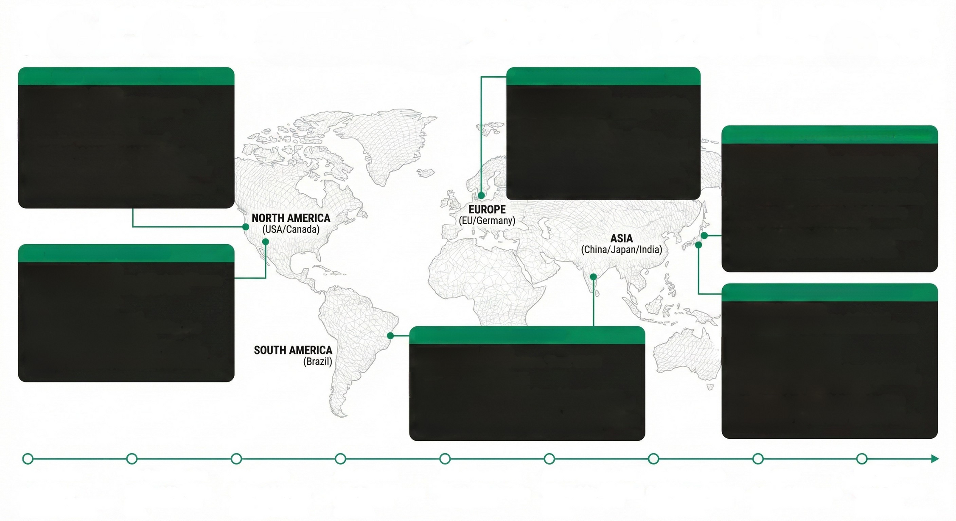
2025 ANNUAL REVIEW: THE GEOPOLITICAL & CYBER LANDSCAPE
CONVERGENCE OF KINETIC CONFLICT, TRADE PROTECTIONISM, & SYSTEMIC CYBER RISK | GLOBAL COST OF CYBERCRIME: +15% YoY.
APRIL 02: US 'LIBERATION DAY' TARIFFS
JAN 17: DORA ENFORCEMENT LIVE
GEOPOLITICAL EVENT:
90+ Country Tariffs. S&P 500 Correction.
Shift to domestic industrial capacity.
GEOPOLITICAL EVENT:
21,000+ entities under strict supervision.
"Compliance Fortress" strategy.
CYBER RISK INSIGHT:
The End of "Neutrality Arbitrage."
CYBER RISK INSIGHT:
Operational Friction vs. Resilience.
Compliance costs surged 15-20%. Initial operational disruption was significant, but the hardened sector weathered the US contagion with minimal direct exposure. The primary residual risk is now the opaque NBFI (shadow banking) sector.
DEC: YEN UNWIND & CHINA'S MANAGED DECLINE
Friendshoring accelerates supply chain bifurcation. Organizations must align with trusted economic nodes, increasing vendor risk complexity. Heightened threat of retaliatory state-sponsored cyber espionage against US industrial targets.
GEOPOLITICAL EVENT:
BoJ Rate Hike to 0.75% ends negative rates.
China's 5% growth target & tech decoupling.
CYBER RISK INSIGHT:
Financial Repatriation & Asymmetric Threats.
The Yen unwind increased global funding costs, exposing hidden leverage. China's decoupling drives use of asymmetric cyber tools for economic leverage and retaliation (e.g., rare earth supply chain disruption).
OCT 17: US BANKING CONTAGION
GEOPOLITICAL EVENT:
Failures of Zions Bancorp & Western Alliance. Panic triggers gold peak at $4,378/oz. Global liquidity freeze.
JULY: AI FRAUD & SUPPLY CHAIN ATTACKS
CYBER RISK INSIGHT:
GEOPOLITICAL EVENT:
Systemic Fragility Exposed.
Basel III delays created vulnerability. The crash validated the EU's DORA approach, Cybercriminals exploit market volatility for phishing and fraud. Increased focus on "unrealized loss" traps as a contagion vector.
India: Deutsche Bank Exec defrauded ₹1.08Cr via Deepfake. GlassWorm Outbreak (Q4).
NOV: COP30 BELEM & CBDC DELAY
GEOPOLITICAL EVENT:
Focus on Adaptation Finance. "Drex" CBDC Pilot delayed to 2026.
CYBER RISK INSIGHT:
The Crisis of Verification.
CYBER RISK INSIGHT:
Deepfakes prove the operational viability of real-time executive impersonation, rendering voice/video verification obsolete.
GlassWorm's invisible Unicode injections
infected 35,800+ VS Code environments,
confirming the "just-in-time" software supply
chain is poisoned.
Digital Currency Stalls.
The Drex delay, alongside the Digital Euro stall, indicates significant technical and regulatory hurdles for CBDCs. This creates a window for private, tokenized deposit schemes to fill the void, introducing new, unregulated risks.
JAN: DORA Live
Cyber Insight:
Compliance costs surge; resilience increases.
FEB: German Election
Cyber Insight: Political stability aids market calm.
APR: US Tariffs
Cyber Insight:
Supply chains fracture; cyber espionage risk rises.
JUN: G7 Summit
Cyber Insight:
Focus on
economic node
alignment.
JULY: AI Fraud (India)
Cyber Insight: Deepfake
víability proven.
AUG: US-India Trade Rift
Cyber Insight: Geopolitical tension creates cyber friction.
OCT: US Bank Crash
Cyber Insight: Regulatory failure exposed; global liquidity freeze.
NOV: COP30
Cyber Insight:
Focus on climate finance cyber risks.
DEC: GlassWorm
Discovery
Cyber Insight:
Dev environment
compromise at scale.

